Slide 1
A Level English Language
What is a verb?
Style Sample
Fricative
Context
Idiolect
Semantic Field
Deictic
Lexis
Language & Power
Audience
Why has the writer used that word?
Genre
Standard & Non-Standard
Analyse
Do men swear more than women?
Create
Is texting damaging language?
Register
Grammar
Commentary
Monologues

Slide 2
Why are you here!?

Slide 3
What is it?
Just because you’re human doesn’t make you capable of performing surgery…
Just because you can drive doesn’t make you a mechanic…
And just because you speak English doesn’t make you an expert on the English Language and how it operates: if it did, they’d give away AS/A2 English Language and Linguistics degrees with breakfast cereal- and they don’t.
This is an entirely different approach to language: it is much more scientific, analytical and very challenging.

Slide 4
How is the course structured?
AS Level
ENGB1: Categorising Texts
ENGB2: Creating Texts
A2 Level
ENGB3: Developing Language
ENGB4: Investigating Language

Slide 5
Learning Objective:
To know how the course is structured
To recognise the difference between being a user of the English Language and being a student of the English Language
Success Criteria:
☑ I know the types of topics we will do
☑ I can explain my understanding of ideas as a user of English Language
☑ I discover my META-LINGUISTIC potential and start thinking about language as a student, rather than just a speaker

Slide 6
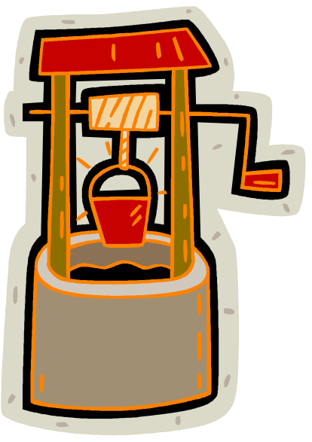




A question on a physics exam using the incident as a case study:
Jack weighs 76kg and carries a pail of water weighing 13kg. He has climbed a hill (gradient 25%).
By falling down 67m and breaking his crown, with what force does Jack hit the rock at the bottom?
What quantities of vinegar and brown paper will be needed to repair the damage?

Slide 7
Text Type: Lucky Dip
Draw a text box in the middle of a Word document. Leave a space around the edge of the box... You will use this for annotating your writing.
You have 25 minutes to rewrite the tale of Jack and Jill in your selected genre...

Slide 8
Analysing Language: An Introduction
Discourse & Pragmatics | ☑ Genre ☑ Register (Formality) ☑ Audience ☑ Mode (Written/ Spoken) ☑ Purpose ☑ Subject
Lexis & Semantics | Word class Semantic Fields Specialist terminology/ jargon
Grammar | Word class Sentence structures (simple, complex, compound) Sentence types (statements, questions)
Phonetics/ Phonology | Alliteration Onomatopoeia Rhyme Rhythm Use of particular sounds
Graphology | Layout & Organisation Font size & style Use of images

Slide 9
A question on a physics exam using the incident as a case study:
Jack weighs 76kg and carries a pail of water weighing 13kg. He has climbed a hill (gradient 25%).
By falling down 67m and breaking his crown, with what force does Jack hit the rock at the bottom?
What quantities of vinegar and brown paper will be needed to repair the damage?

Slide 10
Analysing Language: An Introduction
Discourse & Pragmatics | ☑ Genre ☑ Register (Formality) ☑ Audience ☑ Mode (Written/ Spoken) ☑ Purpose ☑ Subject
Lexis & Semantics | Word class Semantic Fields Specialist terminology/ jargon
Grammar | Word class Sentence structures (simple, complex, compound) Sentence types (statements, questions)
Phonetics/ Phonology | Alliteration Onomatopoeia Rhyme Rhythm Use of particular sounds
Graphology | Layout & Organisation Font size & style Use of images

Slide 11
Let’s look at some of your writing for the key linguistic features

Slide 12
Homework:
For next lesson, review and consolidate the analysing language grid in preparation for tomorrow’s lesson

Slide 13
Learning Objective:
To know how the course is structured
To recognise the difference between being a user of the English Language and being a student of the English Language
Success Criteria:
☑ I know the types of topics we will do
☑ I can explain my understanding of ideas as a user of English Language
☑ I discover my META-LINGUISTIC potential and start thinking about language as a student, rather than just a speaker

Slide 14
Revision: Analysing Language
Discourse & Pragmatics | ☑ Genre ☑ Register (Formality) ☑ Audience ☑ Mode (Written/ Spoken) ☑ Purpose ☑ Subject
Lexis & Semantics | Word class Semantic Fields Specialist terminology/ jargon
Grammar | Word class Sentence structures (simple, complex, compound) Sentence types (statements, questions)
Phonetics/ Phonology | Alliteration Onomatopoeia Rhyme Rhythm Use of particular sounds
Graphology | Layout & Organisation Font size & style Use of images
The text is aimed at students sitting their Physics exam

Slide 15
Revision: Analysing Language
Discourse & Pragmatics | ☑ Genre ☑ Register (Formality) ☑ Audience ☑ Mode (Written/ Spoken) ☑ Purpose ☑ Subject
Lexis & Semantics | Word class Semantic Fields Specialist terminology/ jargon
Grammar | Word class Sentence structures (simple, complex, compound) Sentence types (statements, questions)
Phonetics/ Phonology | Alliteration Onomatopoeia Rhyme Rhythm Use of particular sounds
Graphology | Layout & Organisation Font size & style Use of images
The text is very formal

Slide 16
Revision: Analysing Language
Discourse & Pragmatics | ☑ Genre ☑ Register (Formality) ☑ Audience ☑ Mode (Written/ Spoken) ☑ Purpose ☑ Subject
Lexis & Semantics | Word class Semantic Fields Specialist terminology/ jargon
Grammar | Word class Sentence structures (simple, complex, compound) Sentence types (statements, questions)
Phonetics/ Phonology | Alliteration Onomatopoeia Rhyme Rhythm Use of particular sounds
Graphology | Layout & Organisation Font size & style Use of images
The word choice is very factual, with lots of nouns and few adjectives

Slide 17
Revision: Analysing Language
Discourse & Pragmatics | ☑ Genre ☑ Register (Formality) ☑ Audience ☑ Mode (Written/ Spoken) ☑ Purpose ☑ Subject
Lexis & Semantics | Word class Semantic Fields Specialist terminology/ jargon
Grammar | Word class Sentence structures (simple, complex, compound) Sentence types (statements, questions)
Phonetics/ Phonology | Alliteration Onomatopoeia Rhyme Rhythm Use of particular sounds
Graphology | Layout & Organisation Font size & style Use of images
It uses technical terminology e.g. Force, gradient

Slide 18
Revision: Analysing Language
Discourse & Pragmatics | ☑ Genre ☑ Register (Formality) ☑ Audience ☑ Mode (Written/ Spoken) ☑ Purpose ☑ Subject
Lexis & Semantics | Word class Semantic Fields Specialist terminology/ jargon
Grammar | Word class Sentence structures (simple, complex, compound) Sentence types (statements, questions)
Phonetics/ Phonology | Alliteration Onomatopoeia Rhyme Rhythm Use of particular sounds
Graphology | Layout & Organisation Font size & style Use of images
It asks a question

Slide 19
Revision: Analysing Language
Discourse & Pragmatics | ☑ Genre ☑ Register (Formality) ☑ Audience ☑ Mode (Written/ Spoken) ☑ Purpose ☑ Subject
Lexis & Semantics | Word class Semantic Fields Specialist terminology/ jargon
Grammar | Word class Sentence structures (simple, complex, compound) Sentence types (statements, questions)
Phonetics/ Phonology | Alliteration Onomatopoeia Rhyme Rhythm Use of particular sounds
Graphology | Layout & Organisation Font size & style Use of images
It is organised in bullet points for clarity

Slide 20
Revision: Analysing Language
Discourse & Pragmatics | ☑ Genre ☑ Register (Formality) ☑ Audience ☑ Mode (Written/ Spoken) ☑ Purpose ☑ Subject
Lexis & Semantics | Word class Semantic Fields Specialist terminology/ jargon
Grammar | Word class Sentence structures (simple, complex, compound) Sentence types (statements, questions)
Phonetics/ Phonology | Alliteration Onomatopoeia Rhyme Rhythm Use of particular sounds
Graphology | Layout & Organisation Font size & style Use of images
The sentences are typically simple, with one main clause e.g. ‘He climbed a hill’

Slide 21
Analysing Language
Discourse & Pragmatics | ☑ Genre ☑ Register (Formality) ☑ Audience ☑ Mode (Written/ Spoken) ☑ Purpose ☑ Subject
Lexis & Semantics | Word class Semantic Fields Specialist terminology/ jargon
Grammar | Word class Sentence structures (simple, complex, compound) Sentence types (statements, questions)
Phonetics/ Phonology | Alliteration Onomatopoeia Rhyme Rhythm Use of particular sounds
Graphology | Layout & Organisation Font size & style Use of images
There are some images of the well, pail and Jack and Jill to contextualise the scenario

Slide 22
A question on a physics exam using the incident as a case study:
Jack weighs 76kg and carries a pail of water weighing 13kg. He has climbed a hill (gradient 25%).
By falling down 67m and breaking his crown, with what force does Jack hit the rock at the bottom?
What quantities of vinegar and brown paper will be needed to repair the damage?

Slide 23
Analysing Language: An Introduction
Discourse & Pragmatics | ☑ Genre ☑ Register (Formality) ☑ Audience ☑ Mode (Written/ Spoken) ☑ Purpose ☑ Subject
Lexis & Semantics | Word class Semantic Fields Specialist terminology/ jargon
Grammar | Word class Sentence structures (simple, complex, compound) Sentence types (statements, questions)
Phonetics/ Phonology | Alliteration Onomatopoeia Rhyme Rhythm Use of particular sounds
Graphology | Layout & Organisation Font size & style Use of images

Slide 24
Analysing Language
Discourse & Pragmatics | ☑ Genre ☑ Register (Formality) ☑ Audience ☑ Mode (Written/ Spoken) ☑ Purpose ☑ Subject
Lexis & Semantics | Word class Semantic Fields Specialist terminology/ jargon
Grammar | Word class Sentence structures (simple, complex, compound) Sentence types (statements, questions)
Phonetics/ Phonology | Alliteration Onomatopoeia Rhyme Rhythm Use of particular sounds
Graphology | Layout & Organisation Font size & style Use of images
Label your text with key linguistic features. As well as identifying them, link them back to the Genre, Audience & Purpose

Slide 25
Analysing Language
Discourse & Pragmatics | ☑ Genre ☑ Register (Formality) ☑ Audience ☑ Mode (Written/ Spoken) ☑ Purpose ☑ Subject
Lexis & Semantics | Word class Semantic Fields Specialist terminology/ jargon
Grammar | Word class Sentence structures (simple, complex, compound) Sentence types (statements, questions)
Phonetics/ Phonology | Alliteration Onomatopoeia Rhyme Rhythm Use of particular sounds
Graphology | Layout & Organisation Font size & style Use of images
Analyse how language is used effectively in your text to meet the demands of its genre, audience and purpose
Y
W
R
Q
E
T

Slide 26
Learning Objective:
To know how the course is structured
To recognise the difference between being a user of the English Language and being a student of the English Language
Success Criteria:
☑ I know the types of topics we will do
☑ I can explain my understanding of ideas as a user of English Language
☑ I discover my META-LINGUISTIC potential and start thinking about language as a student, rather than just a speaker

Slide 27

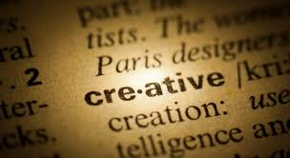



ENGB2
Creating Texts

Slide 28
AS ENGLISH LANGUAGE
ENGB2: CREATING TEXTS
Finding Your Voice:
Reading and Writing in Different Genres
Research and Analysis Project
Summer 2013

Slide 29
Widening Your Reading
Over the holidays we need you to read and experience a wide range of different texts, many of which you will be exploring and potentially writing in preparation for your coursework.
One of the best sources for different types of writing is the broadsheet newspaper; publications such as The Independent, The Guardian, The Observer, The Telegraph and The Times have a really wide range of material, especially at the weekends when, in addition to the usual news reports and features, they include magazines and supplements on areas such as travel, the family, sport, culture (reviews/features on books, theatre, film and music) and sometimes specialist features on food etc.

Slide 30
Your Task
You are going to compile a language scrapbook of different types of text found in a broadsheet newspaper. You can also add in some texts from other sources as well e.g. charity campaign letters from the post at home; music reviews from specialist magazines; and a short story or opening chapter from a novel. Also include any genres that you particularly enjoy reading or writing.

Slide 31
The Process
Study a genre through reading different style samples from that genre.
Focus on a key style sample to deconstruct.
Use our geeky language framework to support precise analysis.
Analyse how the writer uses language linking observations to GRAMPS.
Now we know the key features of the genre...
...we can write our own piece in that genre but on a different subject.

Slide 32
Now take a look at the broadsheet newspapers on your table...
Have a browse through them and see how
many different types of article you can spot...

Slide 33
Let’s have a go at using our analysis process
with a new genre...
Read the article by Tim Key from the front of
The Independent Magazine...
...use your analysis grid to help you to deconstruct the text.

Slide 34
The Process
Study a genre through reading different style samples from that genre.
Focus on a key style sample to deconstruct.
Use our geeky language framework to support precise analysis.
Analyse how the writer uses language linking observations to GRAMPS.
Now we know the key features of the genre...
...we can write our own piece in that genre but on a different subject.

Slide 35
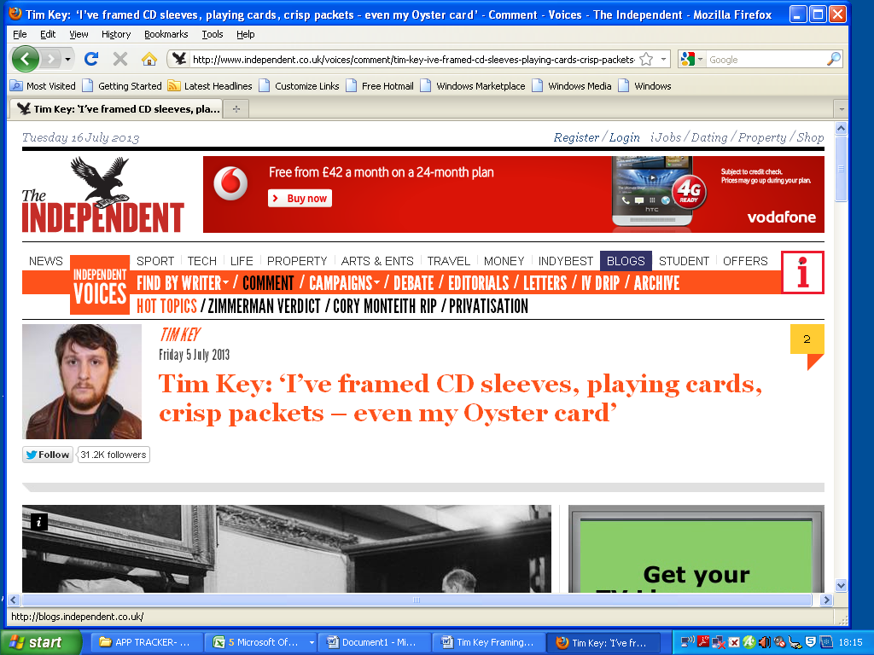

Slide 36
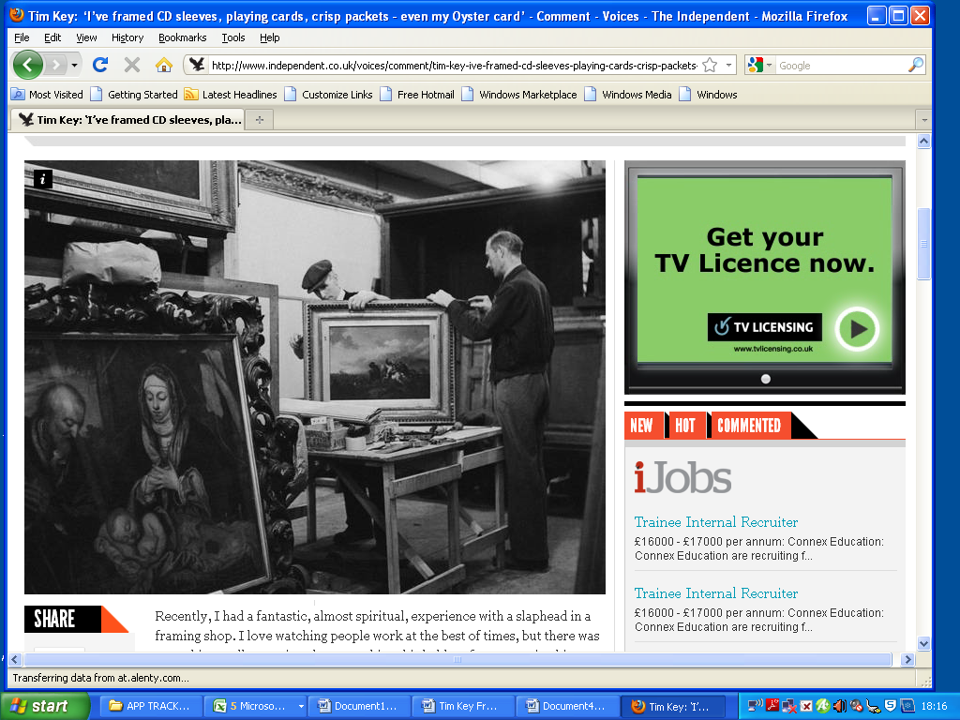

Slide 37
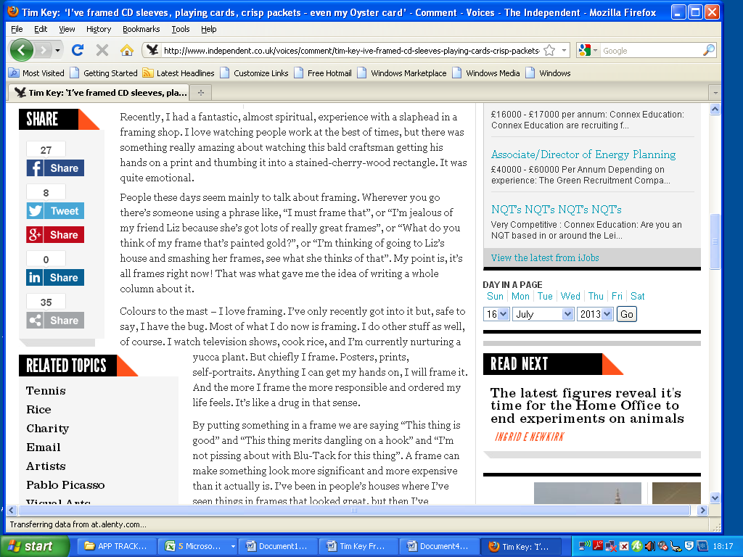

Slide 39
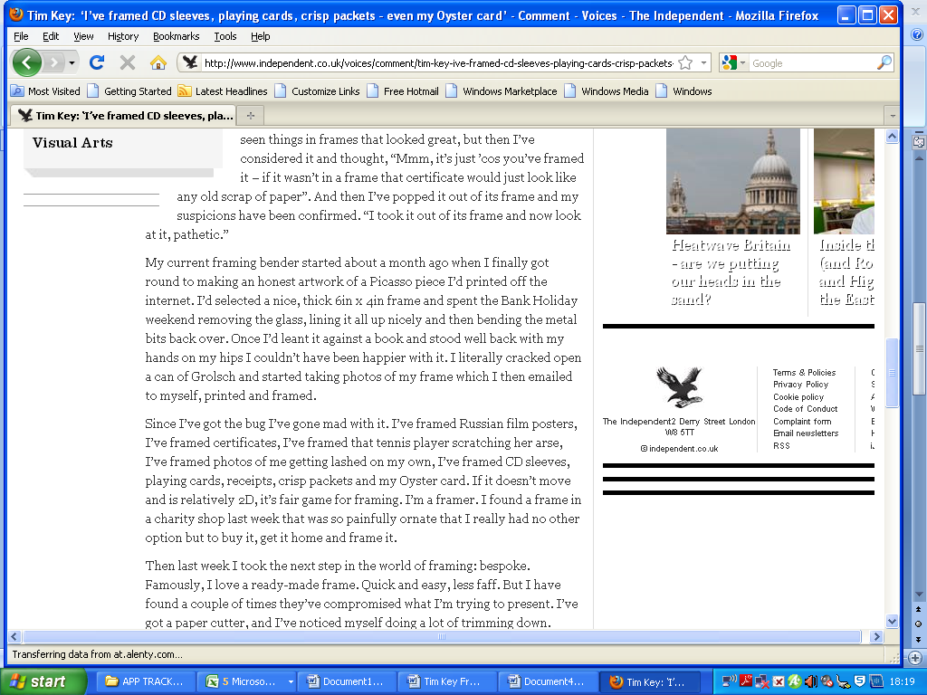

Slide 40
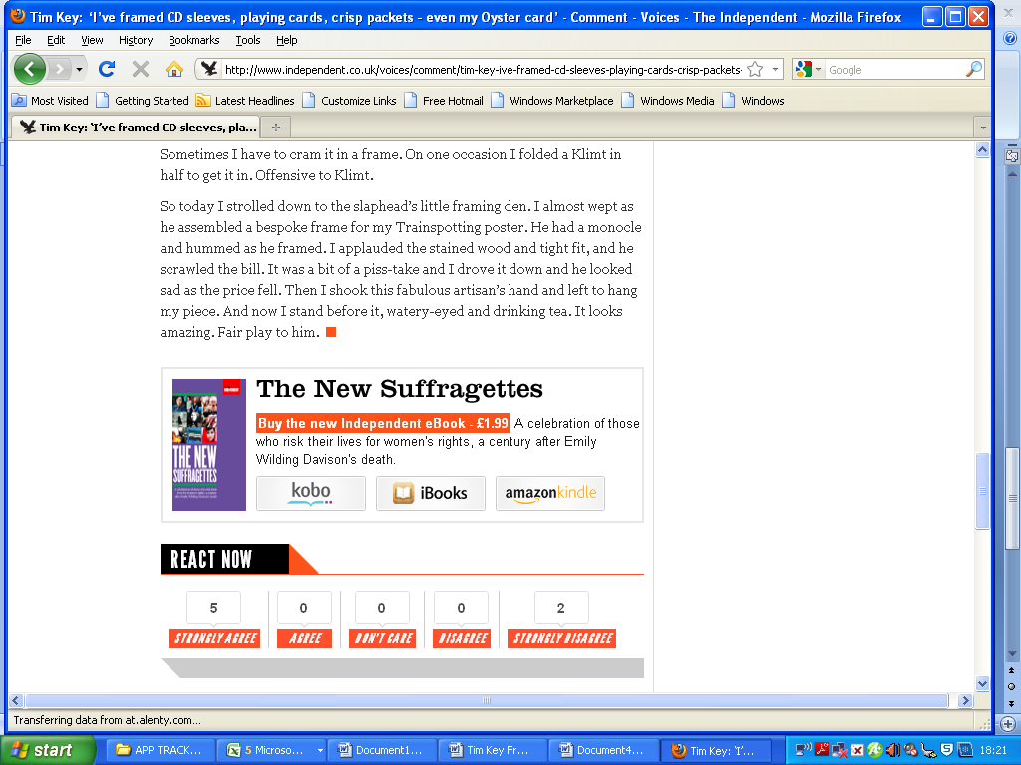

Slide 41
SUBMISSION DATE:
THURSDAY 5TH SEPTEMBER 2013

