Slide 1
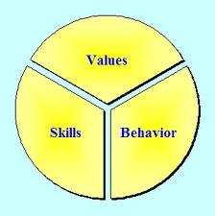
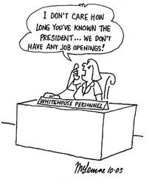
What is recrutimemt?

Slide 2
What is selection?

Slide 3
Unit 2: Recruitment In The Workplace

Slide 4
What is this unit all about?
100% coursework
You investigate the recruitment and selection process and best practice
Create a recruitment and selection process
Trial your process with members of the class
Evaluate your recruitment and selection process

Slide 5
How will the work be assessed?
The content of the course has been divided into individual assignments
The assignments will be completed to set deadlines to form your report
Each assignment will have an assignment sheet that needs to be submitted with your work

Slide 6
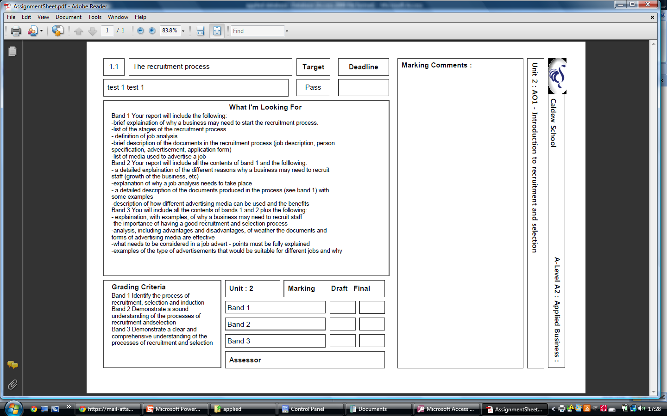
Assignment number
Band 3
Assignment Deadline
Title of the assignment
Your target grade
What you are required to do
Grade awarded
Grading criteria

Slide 7
In groups of 4
Arrange the statements in chronological order to illustrate the stages of the recruitment and selection process in the given company

Slide 8
In groups of 4
Match the stage to the definition
Match both the stage and the definition to the appropriate sections of the story you created earlier

Slide 9
Why might a business need to recruit?
Look at the examples that he have discussed
What other reasons are there?
Band 1
Band 2
Band 3
Reason
Why it is a reason
An example within an organisation of this taking place

Slide 10
Job analysis – Thoughts from the case study
What is meant by the term analysis?
Why does a job analysis need to take place?
When looking at what a job involves, what are the key areas to consider?
How do you think this information is collected if the job already exists in the organisation
How do you think the information is collected if the job doesn’t exist?
Why do you think company aims need to be considered?

Slide 11
Job description
What is a job description?
Indentify and describe the different sections that should be included in the job description
Explain why the job description needs to include the sections that you have mentioned. E.g. What is the purpose of a job title and why is it important?

Slide 12
Person specification
What is a person specification?
Indentify and describe the different sections that should be included in the person specification
Explain why the person specification needs to include the sections that you have mentioned. E.g. What is the purpose of specifying required skills?

