Slide 1
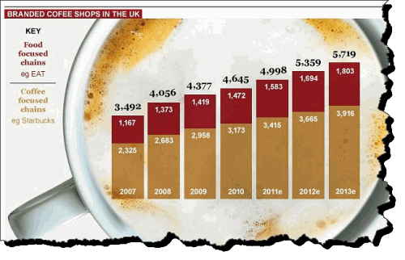

Slide 2
92% market growth anticipated in the e-reader market

Slide 3
Pierre planned to purchase T-shirts and print slogans and messages on them as requested by customers. He wanted to start up a business quickly because he had been told that sales for new businesses in this market grew at 30% per annum. Furthermore, he was aware of a number of businesses planning to enter this market. He also knew that a major competitor, with a 20% market share, was in financial difficulties and expected to stop trading in 2012.

Slide 4
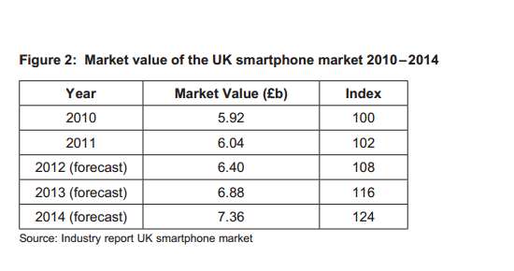

Slide 5
Divine Chocolate Ltd operates in the mass market for Fairtrade chocolate bars.
Fairtrade chocolate sales in the UK grew by 12% in 2009; much faster than
non-Fairtrade sales. Divine Chocolate Ltd’s products are not premium-priced;
recently, a bar of Divine milk chocolate was priced at 81p, compared with 82p for a
similar sized bar of Cadbury Dairy Milk. Price elasticity of demand for chocolate has
been estimated at –0.3 in the UK.

Slide 6
Market research
Upon her appointment, Amina had commissioned a market research agency to investigate trends in
Sound and Vision plc’s current market and the public’s opinions of the company. Its findings were:
● the market for buying pre-recorded music (CDs) and film (DVDs) was predicted to decline in terms
of both volume and value
● the demand for books was expected to be stable, but the competition from both online retailers
and supermarkets would increase
● downloads would continue to be the most popular source of music, especially for the key
15 to 24 year old market
● Sound and Vision plc maintained a good reputation for its high levels of customer service and the
specialist knowledge of its employees, particularly amongst the more affluent 25 to 34 year old
market
● customers liked the wide product range and the individuality of each store

Slide 7
