Slide 1
Review test and update assessment records

Slide 2
Who am I and what is my business?

Slide 3
Alan Sugar

Slide 4
Anita Roddick

Slide 5
Richard Branson

Slide 6
Michael S Dell

Slide 7
Roman Abramovich

Slide 8
Stelios Haji-Ioannou

Slide 9
Karan Bilimoria

Slide 10
Levi Roots

Slide 11
Tony guy

Slide 12
Richard Reed, Adam Balon
and Jon Wright;

Slide 13
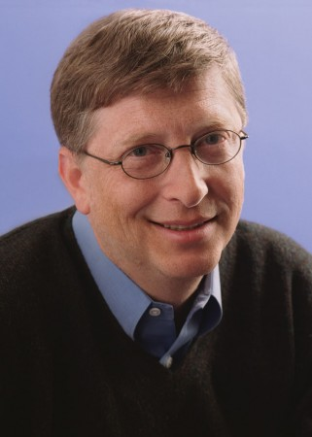
Bill Gates

Slide 14
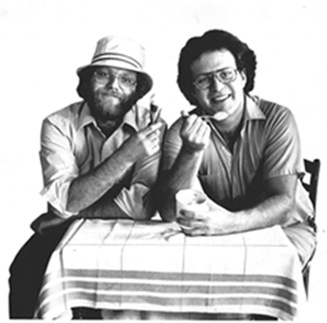
Ben Cohen and Jerry Greenfield

Slide 15
Mark Zuckerberg

Slide 16
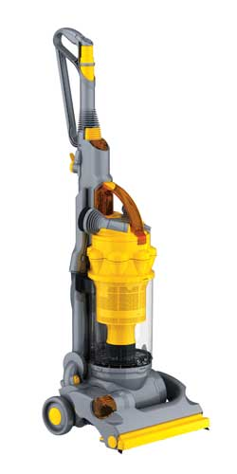
James Dyson

Slide 17
Peter Jones

Slide 18
Learning objectives
To understand what is meant by entrepreneur and enterprise
Appreciate that enterprise involves taking risks, showing initiative and a willingness to undertake new ventures
Recap understanding of goods and services

Slide 19
Learning outcomes
To identify the enterprise skills from a given entrepreneur
To research the characteristics of an entrepreneur that they know or are familiar with and present a fact sheet

Slide 20
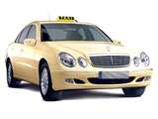
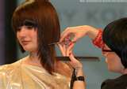
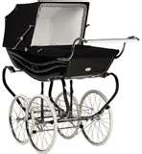
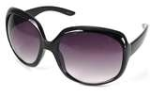
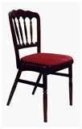
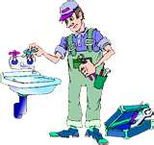
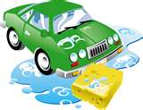
Products
Goods
Services
Non-physical, intangible products
Physical, tangible products

Slide 21
TASK:
GOOD
OR SERVICE?

Slide 22
What makes a person enterprising?
Individual Task:
Draw a person on your A3 sheet
Think of the qualities, characteristics and skills they are likely to have and annotate round the picture.
Paired Task:
Compare your list with a partner and update sheet

Slide 23
Enterprise ???
Can be used as another name for a business
But it also describes the
willingness of an individual to take risks, show initiative and undertake new ventures
So enterprise should be a characteristic of all entrepreneurs

Slide 24
Entrepreneur
A person or group of people who set up and run their own business and are
risk takers.

Slide 25
Dragon’s Den clips
How do these entrepreneurs show enterprise?
http://www.bbc.co.uk/dragonsden/entrepreneurs/angelacoupe.shtml
http://www.bbc.co.uk/dragonsden/entrepreneurs/

Slide 26
So many things can go wrong when setting up a business
Making the first move and making things happen
Always on the look out for new business opportunities

Slide 27
ENTERPRISE WORKSHEET

Slide 28
1. Which three of the following are most likely to be examples of being enterprising?
Choose three answers:
Being made redundant
Carrying out an order from your boss
Taking risks
taking the initiative
Taking your summer holiday at a time convenient for your employer
Undertaking a new venture
Being told that your job will change

Slide 29
2. Which three of the following are examples of services
Choose three answers:
A school desk
A train carriage
A tonne of coal
A train journey
A knife and fork
Menu advice in a restaurant
Education in a state school

Slide 30
3. Lewis Hunting runs a hairdressers. Which one of the following is correct? Select one answer.
Choose one answer:
A haircut is an example of a service
There are no risks in running a hairdressing business
A bottle of shampoo is an example of a service
Lewis Hunting never needs to show initiative in running his business.

Slide 34
Read the case study and identify how Dean has shown enterprise skills

Slide 35
Case study – Dean Fellows Entrepreneur
Dean is a risk taker
Window cleaning business not making as much money as he wanted
Worse things could happen – break a leg, take ill
In his property business he could lose money if property prices fall
New chip fryer - risky if no one wants it
Risk taking
Showing
initiative
A willingness to undertake new ventures
He left his job in the factory to set up window cleaning business
Developing new chip fryer
He makes things happen – shown throughout his working life
Has a history of undertaking new ventures
Always on the look out for new business opportunities – moving from working in a factory to cleaning houses to running a fish and chop shop show ability to take new challenges

Slide 36
Task
Individually write one
quality or characteristic
an entrepreneur would need

Slide 37
Characteristics of an entrepreneur
Physically resilient and in good health.
Risk takers
Show initiative – making things happen
Decision maker
Leadership
Hard working
Creative
Adaptable to change
Persistent
Problem solver
Innovative
High energy levels
Drive
Determination

Slide 38
PAIRED COMPUTER TASK – presentation
Each pair to have a different entrepreneur

Slide 39
Home learning

