Slide 1
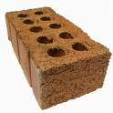
Different uses
What can a brick be used for?
You could build a wall or use it as a door stop.
List as many possible uses you can for a brick.

Slide 2
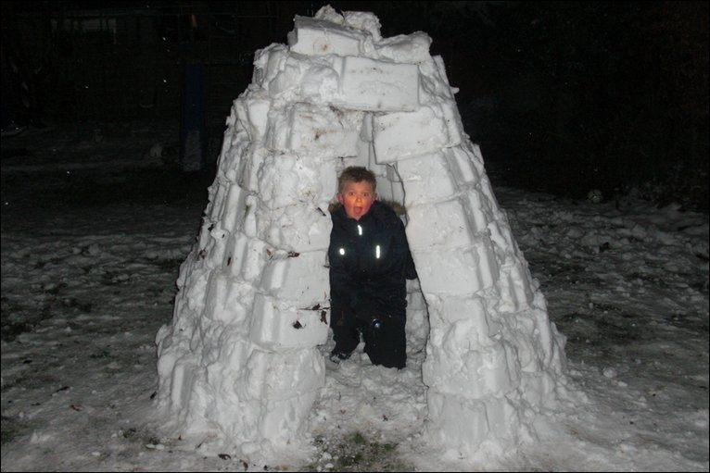
Now you have 2 minutes to draw a house:
Semi detached (1)
One chimney (1)
Garden path (1)
4 windows (1)
Letterbox (1)
Welcome sign on door (1)
Sun in background (1)
Tree in background (1)
Garage (1)
2 birds in sky (1)
Curtains in windows (2)

Slide 3
Learning Objective
Understand that creative ideas are a key aspect to setting up a new business and developing a competitive advantage
Learning Outcomes
Explain what is meant by lateral and blue skies thinking
Explain how creative thinking can benefit a business

Slide 4
Thinking creatively (or creative thinking)
Coming up with new and unique ideas.
Can give a new business a competitive advantage.

Slide 5
Competitive Advantage
An advantage a business has that enables it to perform better than its rivals in the market, such as:
Better or unique product
Better way of producing it
Better customer service
Better or unique technology

Slide 6
Deliberate thinking
The intentional creation of new ideas through recognised and accepted techniques.
Involves Lateral Thinking

Slide 7
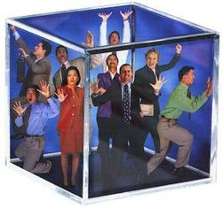
Lateral thinking
‘Thinking outside of the box’
Thinking differently to try and find new and unexpected ideas
Techniques include:
Blue Skies Thinking and
The Six Thinking Hats

Slide 9
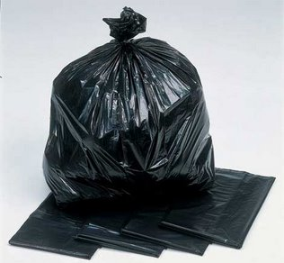
Blue Skies thinking
In your groups, write down the things that come into your mind about a bin liner........
No thoughts are ‘unimportant’ or ‘silly’ or ‘not worth having’

Slide 10
Blue Skies thinking
Bag
Plastic
Cheap
Bin
On a roll
Black
Refuse
Recycling
Xmas presents
Tip
Lorry
Supermarket
Cupboard
Dirty
Strong
Ripped
Run out
Ripped
Fancy dress
Thin
Too small
Tie handle
Spill out

Slide 11
Now you are thinking about how to come up with a new creative way of selling / marketing bags – cross out the words that are not useful – any good ideas left to work on?

Slide 12
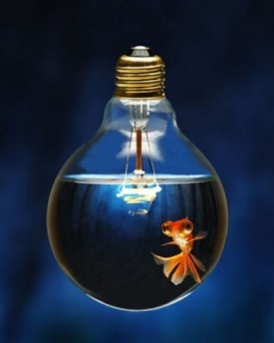
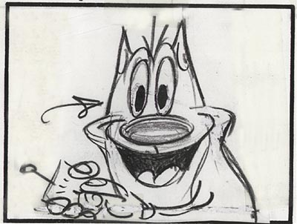
To start........ Creativity in the classroom
Take a piece of paper & pen. You will be given the name of an object. You have 30 seconds to think of as may uses as possible for that item. Do not discuss!
A cotton bud
A piece of tissue paper
A sponge
A loo roll insert

Slide 13
Lesson 2

Slide 14
Why is creativity important to a business?

Slide 15
Making connections
Mindmaps
Mindmaps are used to help us think about our ideas, plan ahead and explore opportunities. The central idea/theme is at the centre and any words or ideas linked to this flow from the keyword.

Slide 16
Look at the Creative Genius Mindset -What actions, qualities and strategies do creative people use?
TASK: Create a mind map showing your skills

Slide 17
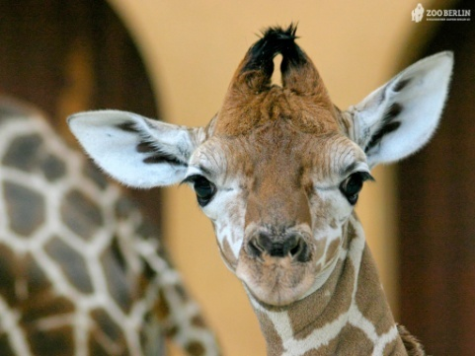
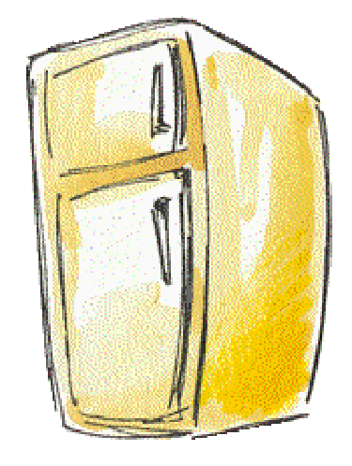
Question 1
How do you put a giraffe into a refrigerator?
The correct answer is:
Open the refrigerator, put in the giraffe and close the door. This question tests whether you tend to do simple things in an
overly complicated way.

Slide 18
Question 2
2. How do you put an elephant into a refrigerator ?
Wrong Answer: Open the refrigerator, put in the elephant and close the refrigerator.
Correct Answer: Open the refrigerator, take out the giraffe, put in the elephant and close the door. This tests your ability to think through the
repercussions of your actions.

Slide 19
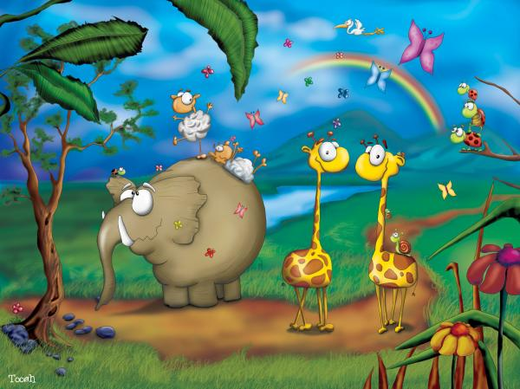
Question 3
3. The Lion King is hosting an animal conference, all the animals attend except one. Which animal does not attend?
Correct Answer: The Elephant. The Elephant is in the refrigerator. This tests your memory. OK, even if you did not answer the first three questions, correctly you can surely answer this one.

Slide 20
Question 4
4. There is a river you must cross. But it is inhabited by crocodiles. How do you manage it?
Correct Answer: You swim across. All the crocodiles are attending the Animal Meeting! This tests whether you learn quickly from your mistakes. FACT: Around 90% of the professionals they tested got all questions wrong. But many preschoolers got several correct answers.

Slide 21
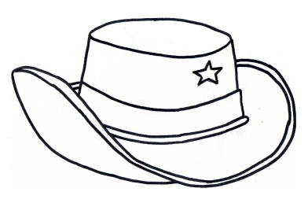
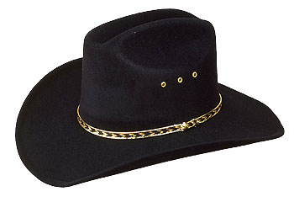
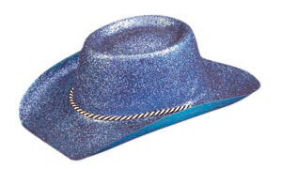
SIX THINKING HATS
Blue skies thinking involves putting all ideas down on paper. ‘Six Thinking Hats’ is a technique that helps organise and focus these ideas.
Facts
Emotions and
gut feelings
Problems and
difficulties
Positive
aspects
Creative
thinking
Thinking about thinking /
managing and leading

Slide 22
Six thinking Hats
White Hats – Facts
What were the facts and problems you encountered when doing the house activity?

Slide 23
Six thinking Hats
Red Hats – Emotions and Feelings
Did you have any gut feelings about your ideas for the bin bags?

Slide 24
Six thinking Hats
Black Hats – problems and difficulties
Where there any problems that you though of when looking at the bin bag idea?

Slide 25
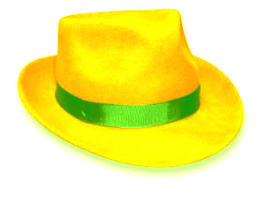
Six thinking Hats
Yellow Hats – Positive aspects
What might be the opportunities of your bin bags?

Slide 26
Six thinking Hats
Green hats – This is creative thinking
Did you prefer the house activity without instructions or with instructions – which one let you be more creative?

Slide 27
Six thinking Hats
Blue Hats – Organising and managing
Did you take a role at leading your group during the activity?
Do you think about what you have learnt and how ideas could be better?

Slide 28
Look at the statements and decide which colour hat they belong to......
RED - Emotions and gut feelings
WHITE - All about facts
BLACK - Problems and difficulties
YELLOW - Positive aspects of ideas
GREEN - Creative thinking
BLUE - Thinking about thinking

Slide 29
1. Jane attends a Blue Skies Thinking course in setting up a business, which one of the following is most likely to be correct: Blue skies thinking:
Will put him at a competitive advantage when he starts up his own business
Is an example of deliberate creative thinking
Is the opposite of lateral thinking
Discourages people from thinking of new ideas

Slide 30
2. Alice is setting up a sandwich business, which one of the following is most likely to give her business a competitive advantage:
High quality locally sources materials
High borrowing costs
Shorter opening hours than competitors
Expensive rent on premises

Slide 31
3. Which TWO of the following best describes the process of lateral thinking:
A management day spend paintballing which helps to build teamwork
Where a business advertises for someone who is highly creative to fill a position
A process that provides a structure for encouraging creativity throughout the business
A period of three days a week put aside to focus on creativity for the managing director
A means of involving and encouraging staff at all levels to think about changes and improvements
A process that required the hiring of professional creative thinkers to act as consultants for the business

Slide 32
4. Courtney Farnham is investigating setting up in business as a dance teacher and is thinking particularly of how she could attract pupils to take up her dance classes. Which one of the following is most likely for her to be an example of lateral thinking about attracting customers? Select one answer.
She will have to give up her present job with a salary of £20,000 a year
It would be a good idea for her to take out insurance in case of accidents to her pupils
She should get advice from experts on how to set up a business
She could give singing lessons for pupils that wanted to perform in musicals

Slide 33
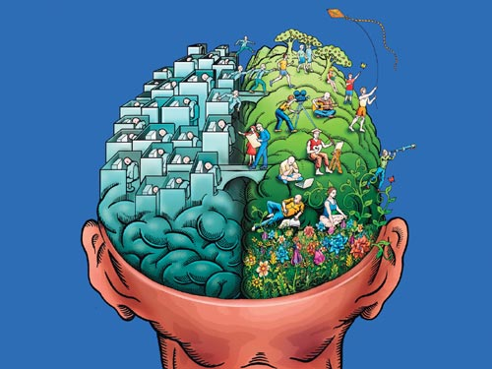
Super!
Remember, successful business need creativity
Any questions?

Slide 34
Case Study – Over to you

Slide 35
Your enterprise and creative thinking
Consider the enterprise challenge you did :
Explain which “hat” you were wearing and why
Explain the strengths and weaknesses of your team
Did your team involve any deliberate thinking techniques?
What could have been better about your pitch?

