Slide 1
Appreciate the importance of brands as an aid to product trial and repeat purchase Understand the need to differentiate products
LEARNING OBJECTVIVES
LEARNING OUTCOMES
Categories a number of products into their “type of brand”
Suggest ways in which a business can differentiate their products

Slide 2
TASK 1
You have 1 minute
Name all the brands on the sheet.

Slide 3
D
A
C
B
G
H
E
F
I
K
J

Slide 4
T
A
S
K
1
Manchester
United
Coke
Ford
MSN Messenger
Adidas
Body Shop
X box
Cadbury
Tesco
Motorola
Mc Donalds

Slide 5
Branding
The adoption of image, name and features for a produce which makes it recognisable for the consumer .
It distinguishes it from competitors

Slide 6
Branding
Businesses with a strong brand will find it easier to gain repeat business and tempt customers with product trials

Slide 7
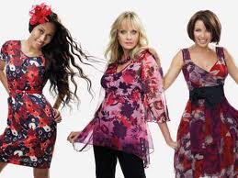
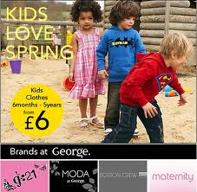
Discussion Point
What image do you associate with:
The Marks and Spencer's brand
The George (Asda’s clothing range)
How do the company's create this image
What benefits do you think it brings them

Slide 8
GENERIC PRODUCTS

Slide 9
BRANDS

Slide 10
OWN BRAND PRODUCTS

Slide 11
BRANDED PRODUCTS
Branded Product – A product that is
and sold under the name of a
specific businesses brand

Slide 12
TASK - Put the products into the correct category

Slide 14
Top 30 brands ($)millions

Slide 15
So, what are the benefits of branding?
Greater customer awareness
Premium Price
Increased sales – repeat buying
Customer loyalty

Slide 16
Product Range
Businesses often sell a range of products to meet different customer needs but use the same branding.

Slide 17
Example of JVC Product Range

Slide 18
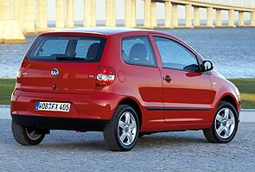
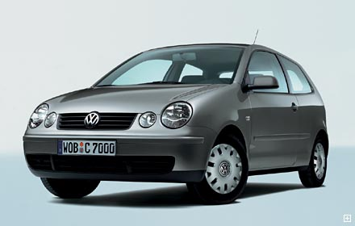
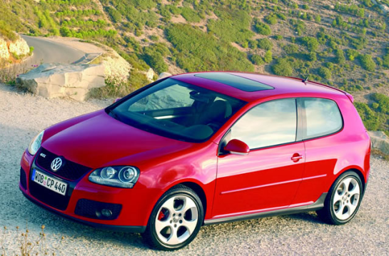
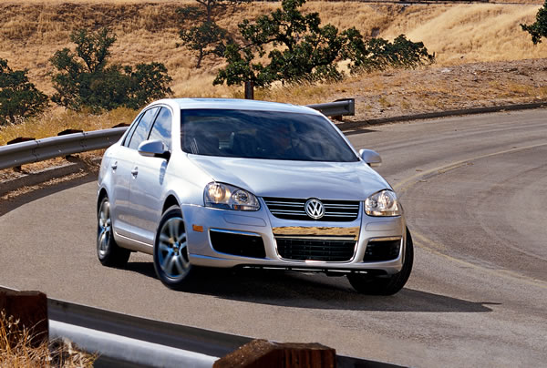
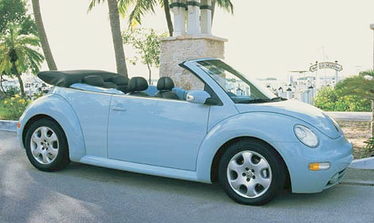
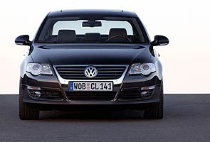
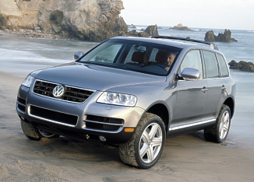
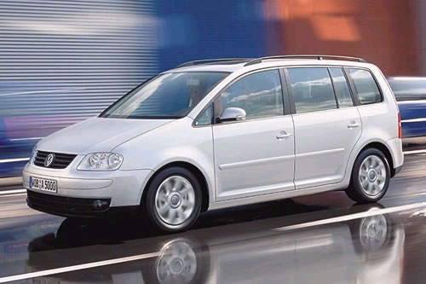
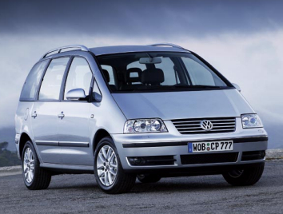
Volkswagen… Its product portfolio
FOX
POLO
GOLF
JETTA
10 basic models in 123 variants sold in the UK alone as at June 2006!
BETTLE
PASSAT
PHAETON
TOUAREG
TOURAN
SHARAN

Slide 19
Product Differentiation
features
Quality
Advertising
Design
Packaging
Price

Slide 20
How are mobile phones differentiated?
Colours
Quality of camera
Radios
Blue Tooth
Price plans
Touch screens / keypads

Slide 21
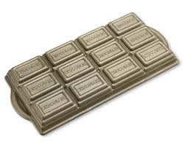
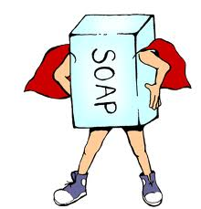
For the product you have been given, you are to consider how you could differentiate it for 3 different segments of the market – 5 mins:
Examples of segments:
Female
Males
Teenagers
Professional business people
Health conscious people
OAPs
Young families
Young Children
Socio economic grouping

